Slide 1
YOUR COMMUNITY FOUNDATION

Slide 2
Welcome
Introductions
Let’s talk TFEC
Let’s talk GHCF Grantmaking
What to expect from us
Questions/Comments
Thank you for joining us today!

Slide 3
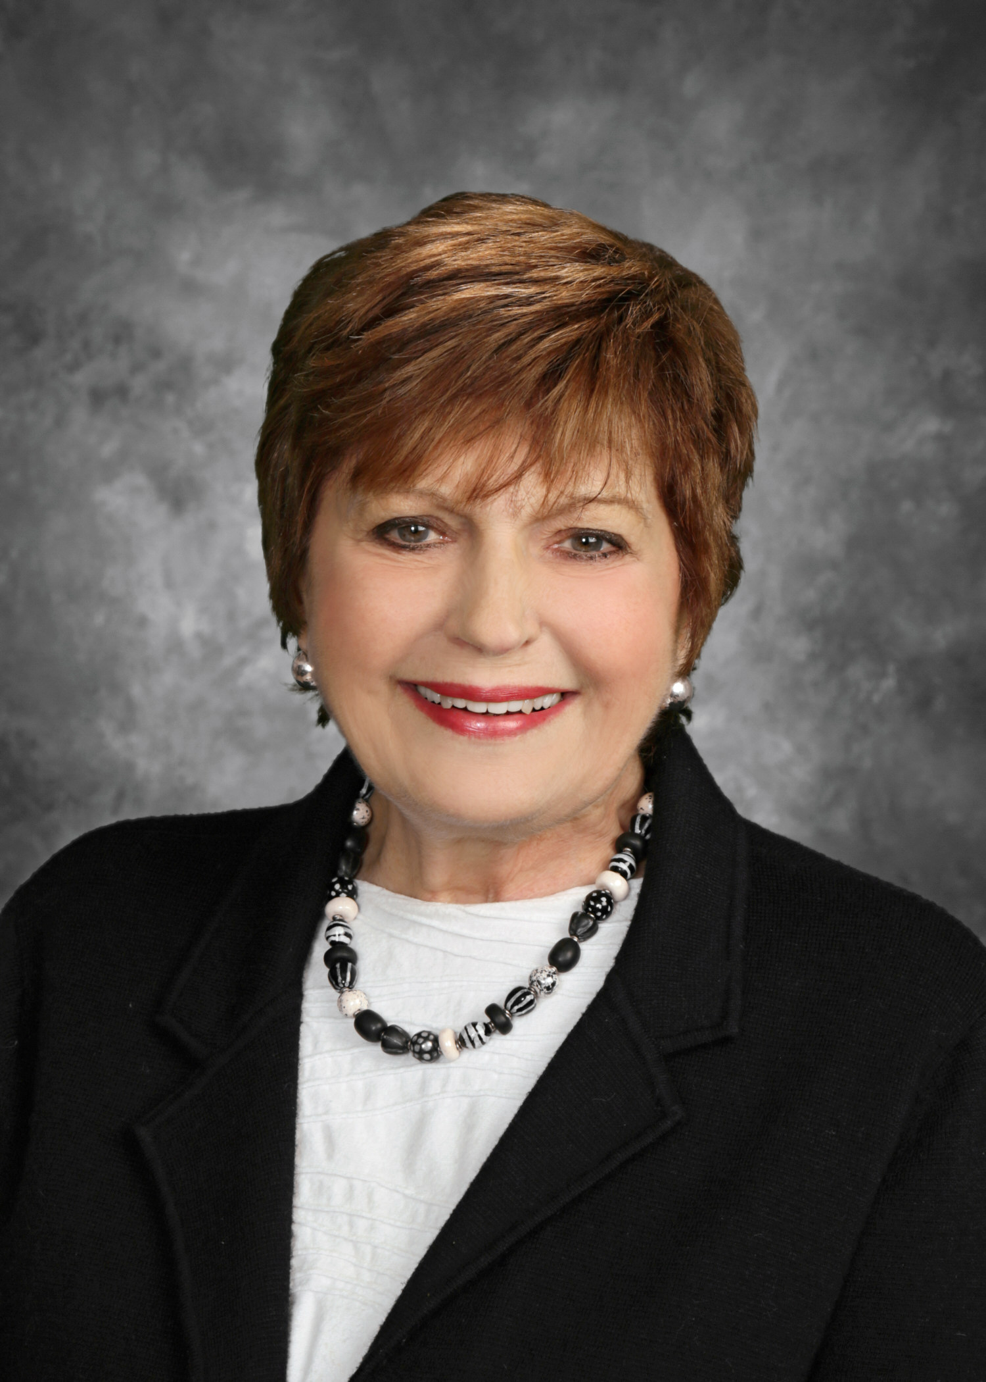
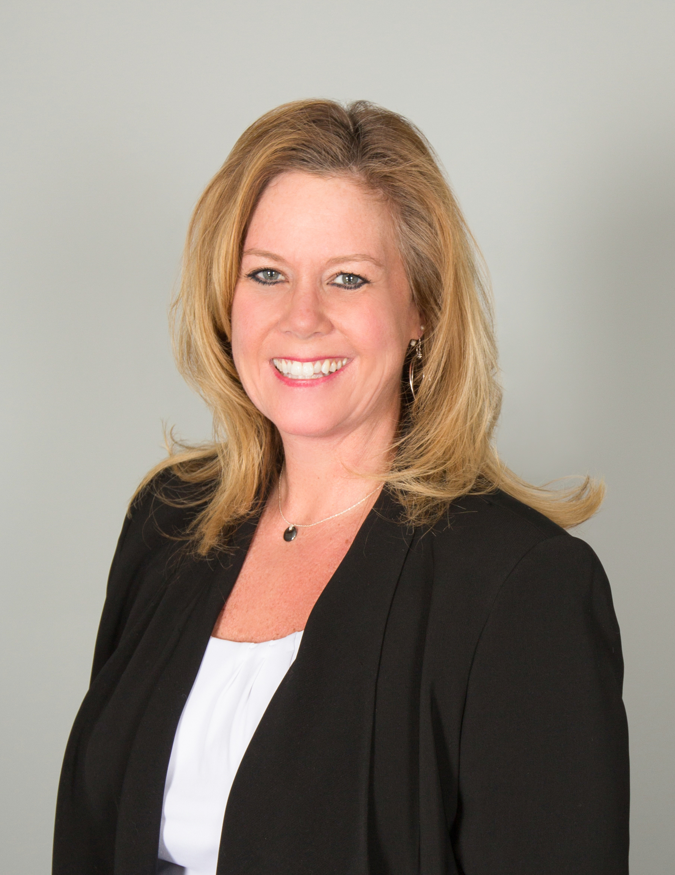
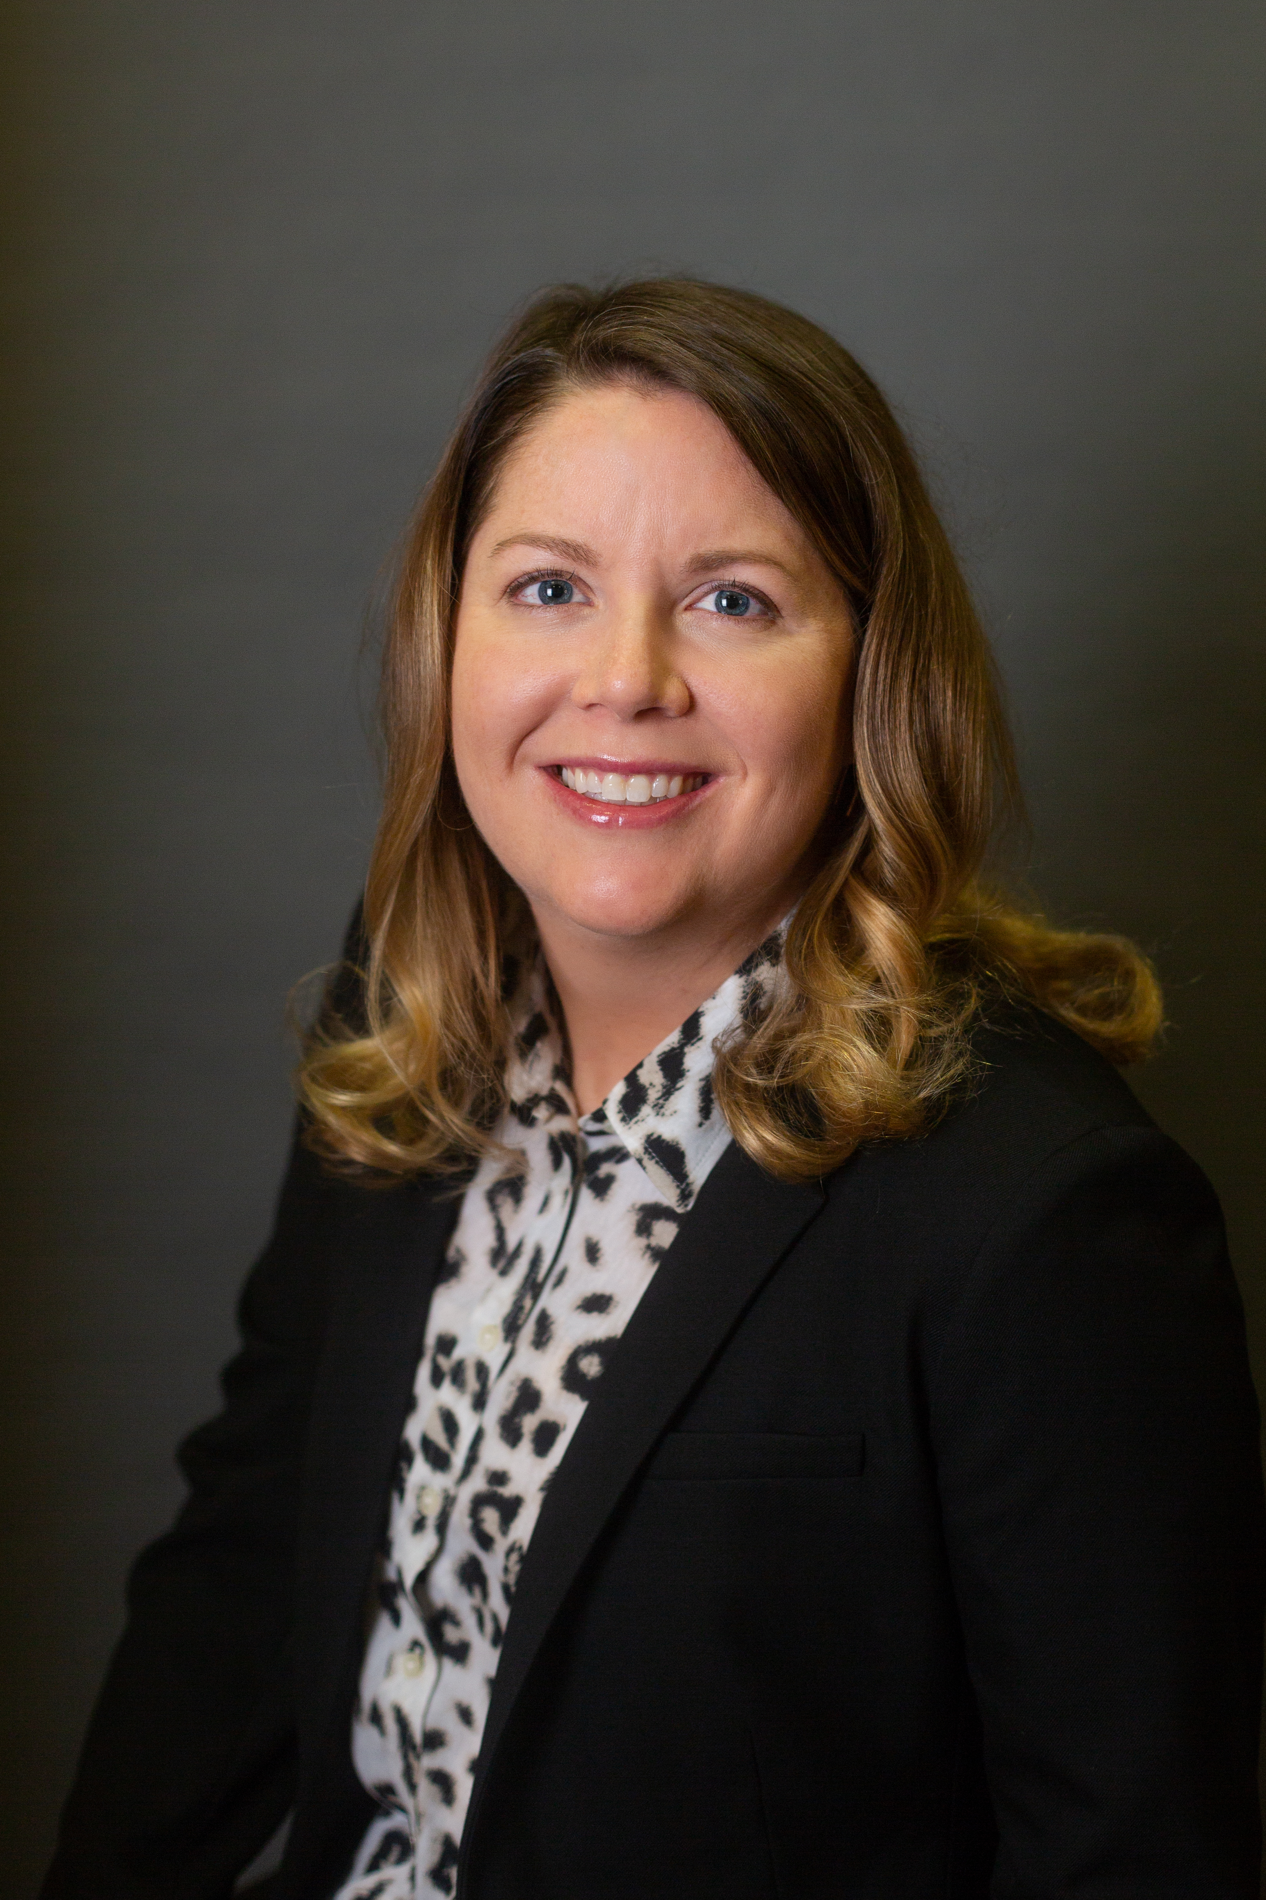
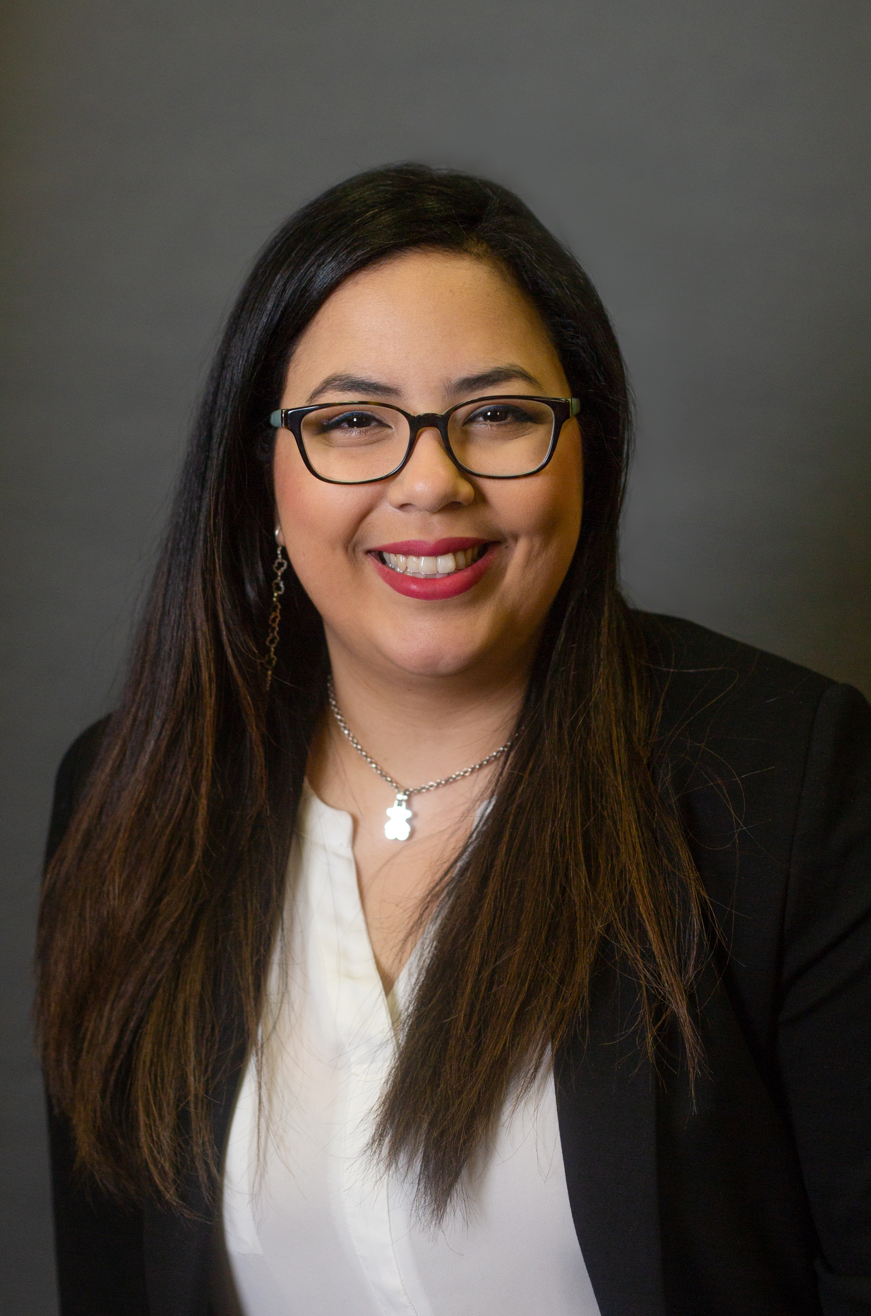
INTRODUCTIONS
Janice R. Black
President & CEO
Jennifer Doyle
Vice President of Philanthropy & Community Investment
Jennifer Strechay
Program Officer for Community Investment
Andrea R. Iguina-Pérez
Community Investment Associate

Slide 4
Let’s talk TFEC

Slide 5
WHAT IS A COMMUNITY FOUNDATION?
501(c)(3) nonprofit public charity
Invest and administer funds
Identify and respond to community’s needs
Overseen by volunteer board and committees
Work with families, individuals, corporations, nonprofits, and professional advisors

Slide 6
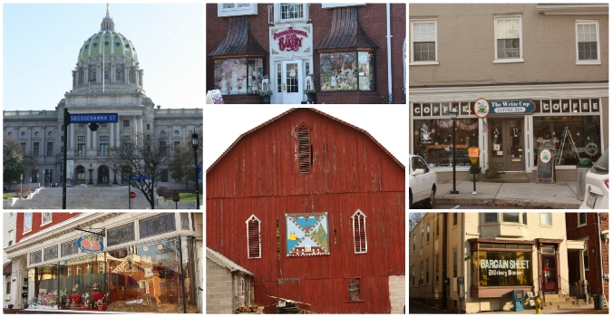
WHAT IS TFEC?
Established in 1920 by Donald McCormick as the Greater Harrisburg Foundation
Overseen by a volunteer Board of Directors comprised of leaders from the local community
Comprised of 5 regional foundations:
Dillsburg Area Community Foundation
Franklin County Community Foundation
Greater Harrisburg Community Foundation
Mechanicsburg Area Community Foundation
Perry County Community Foundation

Slide 7
STRATEGIC PLAN

Slide 8
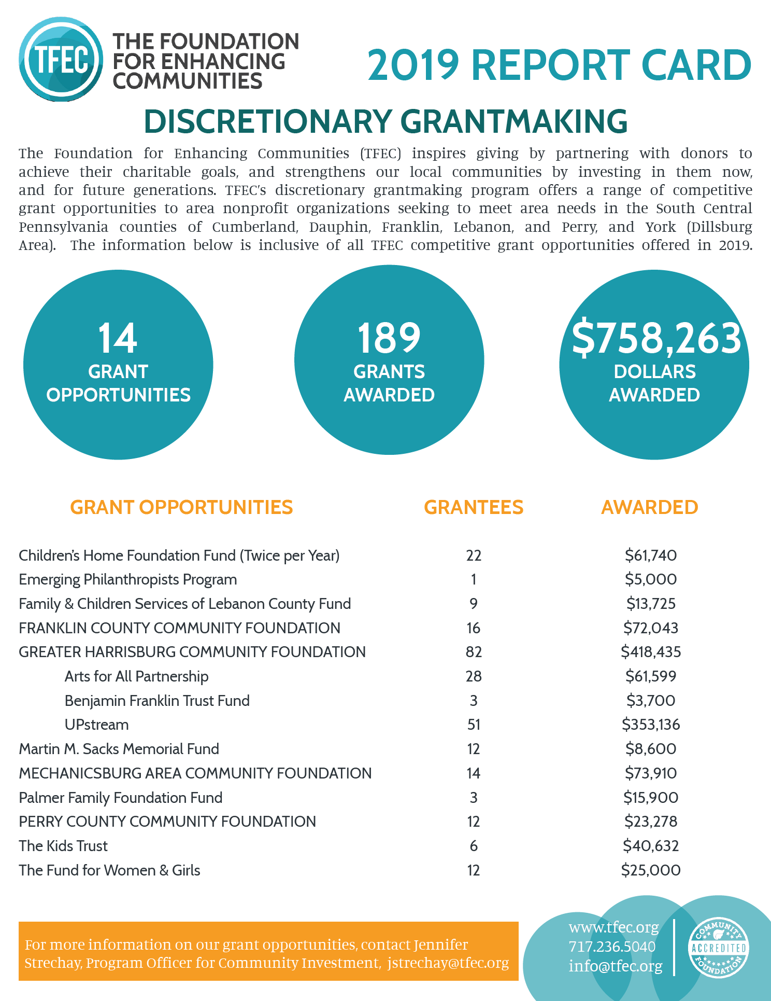
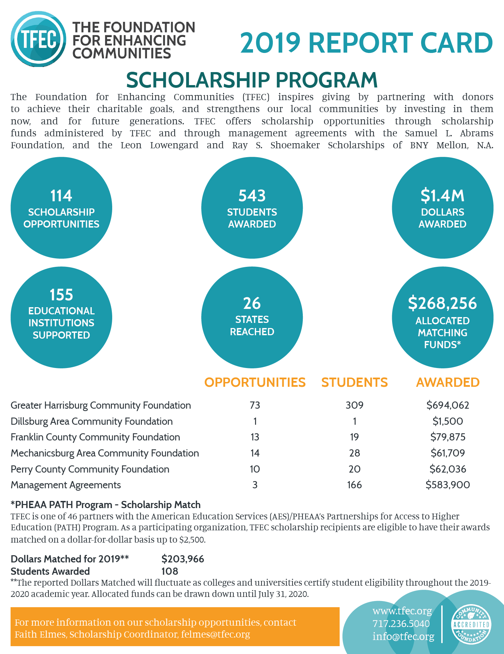
2019 TFEC REPORT CARD

Slide 9
TFEC GRANT OPPORTUNITIES
FALL OPPORTUNITIES
Applications Available April 1, 2020; Deadline August 1, 2020
Arts for All Partnership, Children’s Home Foundation Fund, Franklin County Community Foundation, Mechanicsburg Area Community Foundation, Greater Harrisburg Community Foundation: Benjamin Franklin Trust Fund, Greater Harrisburg Community Foundation: UPstream, Martin M. Sacks Memorial Fund, and The Fund for Women & Girls
Applicants will be notified of their status on or before December 1, 2020
Proposed projects may take place at any time between January 1, 2021-December 31, 2021
SPRING OPPORTUNITIES
Applications Available October 1, 2020; Deadline February 1, 2021
Children’s Home Foundation Fund, Family & Children’s Services of Lebanon County Fund, The Kids Trust Fund, and the Perry County Community Foundation
Applicants will be notified of their status on or before June 1, 2021
Proposed projects may take place at any time between July 1, 2021-June 30, 2022

Slide 10
Let’s talk GHCF Grantmaking

Slide 11
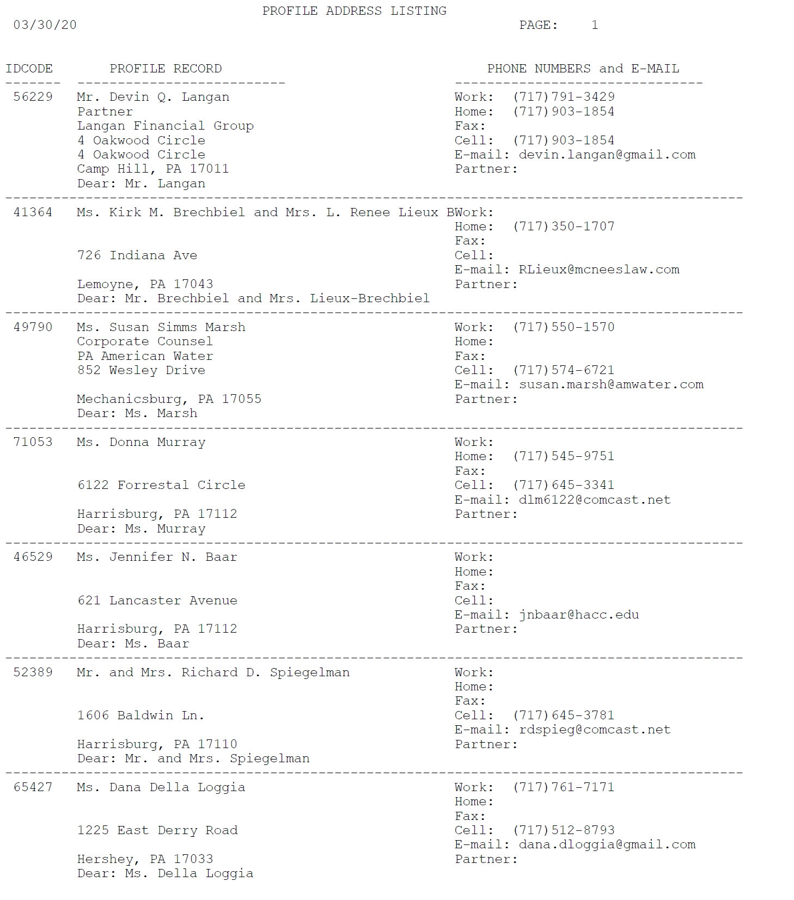
2020 GHCF ADVISORY COMMITTEE
Richard D. Spiegelman- Chair
Devin Q. Langan
Renee Lieux
Susan Simms Marsh
Donna Murray
Jennifer N. Baar
Dana Della Loggia
Esmeralda Hetrick
Nicole S. Kaylor
David W. Kutz

Slide 12
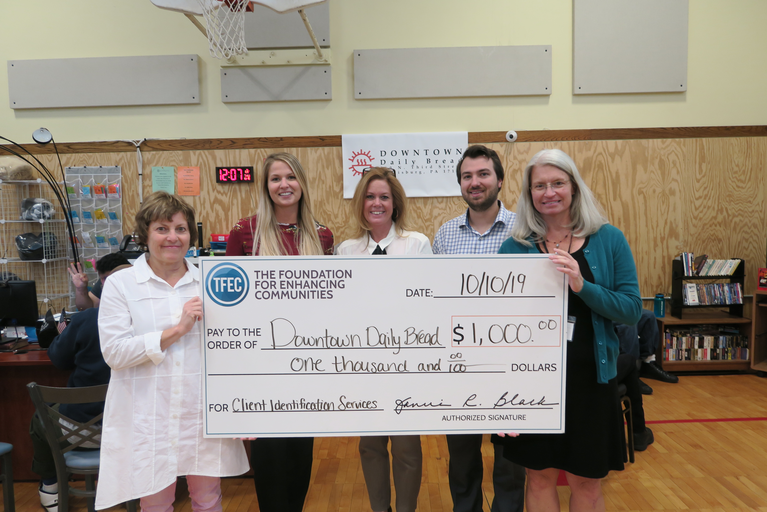
GHCF CHARTER ADOPTED 5.20.28
PURPOSE
The Greater Harrisburg Community Foundation (GHCF) Advisory Committee is charged with overseeing the discretionary grant program of the Greater Harrisburg Community Foundation, a regional foundation of The Foundation for Enhancing Communities. GHCF serves the entire TFEC service area of Cumberland, Dauphin, Franklin, Lebanon, Perry Counties and the Dillsburg area of northern York County. GHCF currently oversees the following grant opportunities:
Arts for All Partnership (separate advisory committee)
Early Childhood Strategic Initiative: Phases 1, 2, and 3
Emergent Needs
GHCF Benjamin Franklin Trust Fund
GHCF UPstream
Patricia L. Murray Fund

Slide 13
GHCF CHARTER ADOPTED 5.20.28
SERVICE
Committee service includes the evaluation of grant applications, and upon reaching consensus, making recommendations to the TFEC Board of Directors on discretionary grants from the unrestricted and area of interest funds of GHCF. The Committee will be guided by the grant guidelines of each GHCF grant initiative and is responsible for revising grant guidelines when appropriate, overseeing evaluation of funded proposals, being aware of community needs and innovative programs, ensuring grants are distributed according to donor intent, and maintaining positive relationships with community partners.
In addition, the Committee will:
Advocate for TFEC in the community and participate in the long-term stewardship of our community
Engage TFEC Board members and others in the community on the value and impact GHCF grants have in the community
Serve as ambassadors for unrestricted giving
Serve as a resource to the TFEC team in connection with objectives, provide expertise and information, and participate in events, programs, and activities
On the periphery, assist the TFEC team in identifying unrestricted and area of interest donor prospects, and when necessary, participate in prospect visits
Coordinate efforts with other TFEC committees when necessary, such as the Communications Committee

Slide 14
GHCF CHARTER ADOPTED 5.20.28
STRUCTURE
9 members who are representative of the geographic region that GHCF serves subject to approval of the Board of Directors.
The Chair of the TFEC Board will appoint the Committee’s Chair and additional members subject to approval of the Board of Directors. Non-Board members may be appointed based upon their expertise and knowledge of the community.
Term limits; a term is three years and a second consecutive term of three years can be served.
The Committee meets two to four times per year and as needed.
Provide regular activity reports to the Board of Directors.
The Program Officer for Community Investment will staff the Committee, and the Vice President of Philanthropy & Community Investment and the President/CEO will serve as members.

Slide 15
UPCOMING GHCF GRANTMAKING MEETING DATES
GRANT OVERVIEW
September 22, 2-3:30 pm
Location: TFEC Boardroom or ZOOM
Purpose: This meeting will cover all GHCF Grant related news and will serve as an overview session for our Fall grant reading
GRANTMAKING
October 27, 1-3:30pm
November 5, 1-3:30pm
Location: TFEC Boardroom or ZOOM
Purpose: GHCF Upstream & Benjamin Franklin Trust Fund Grantmaking Meetings.

Slide 16
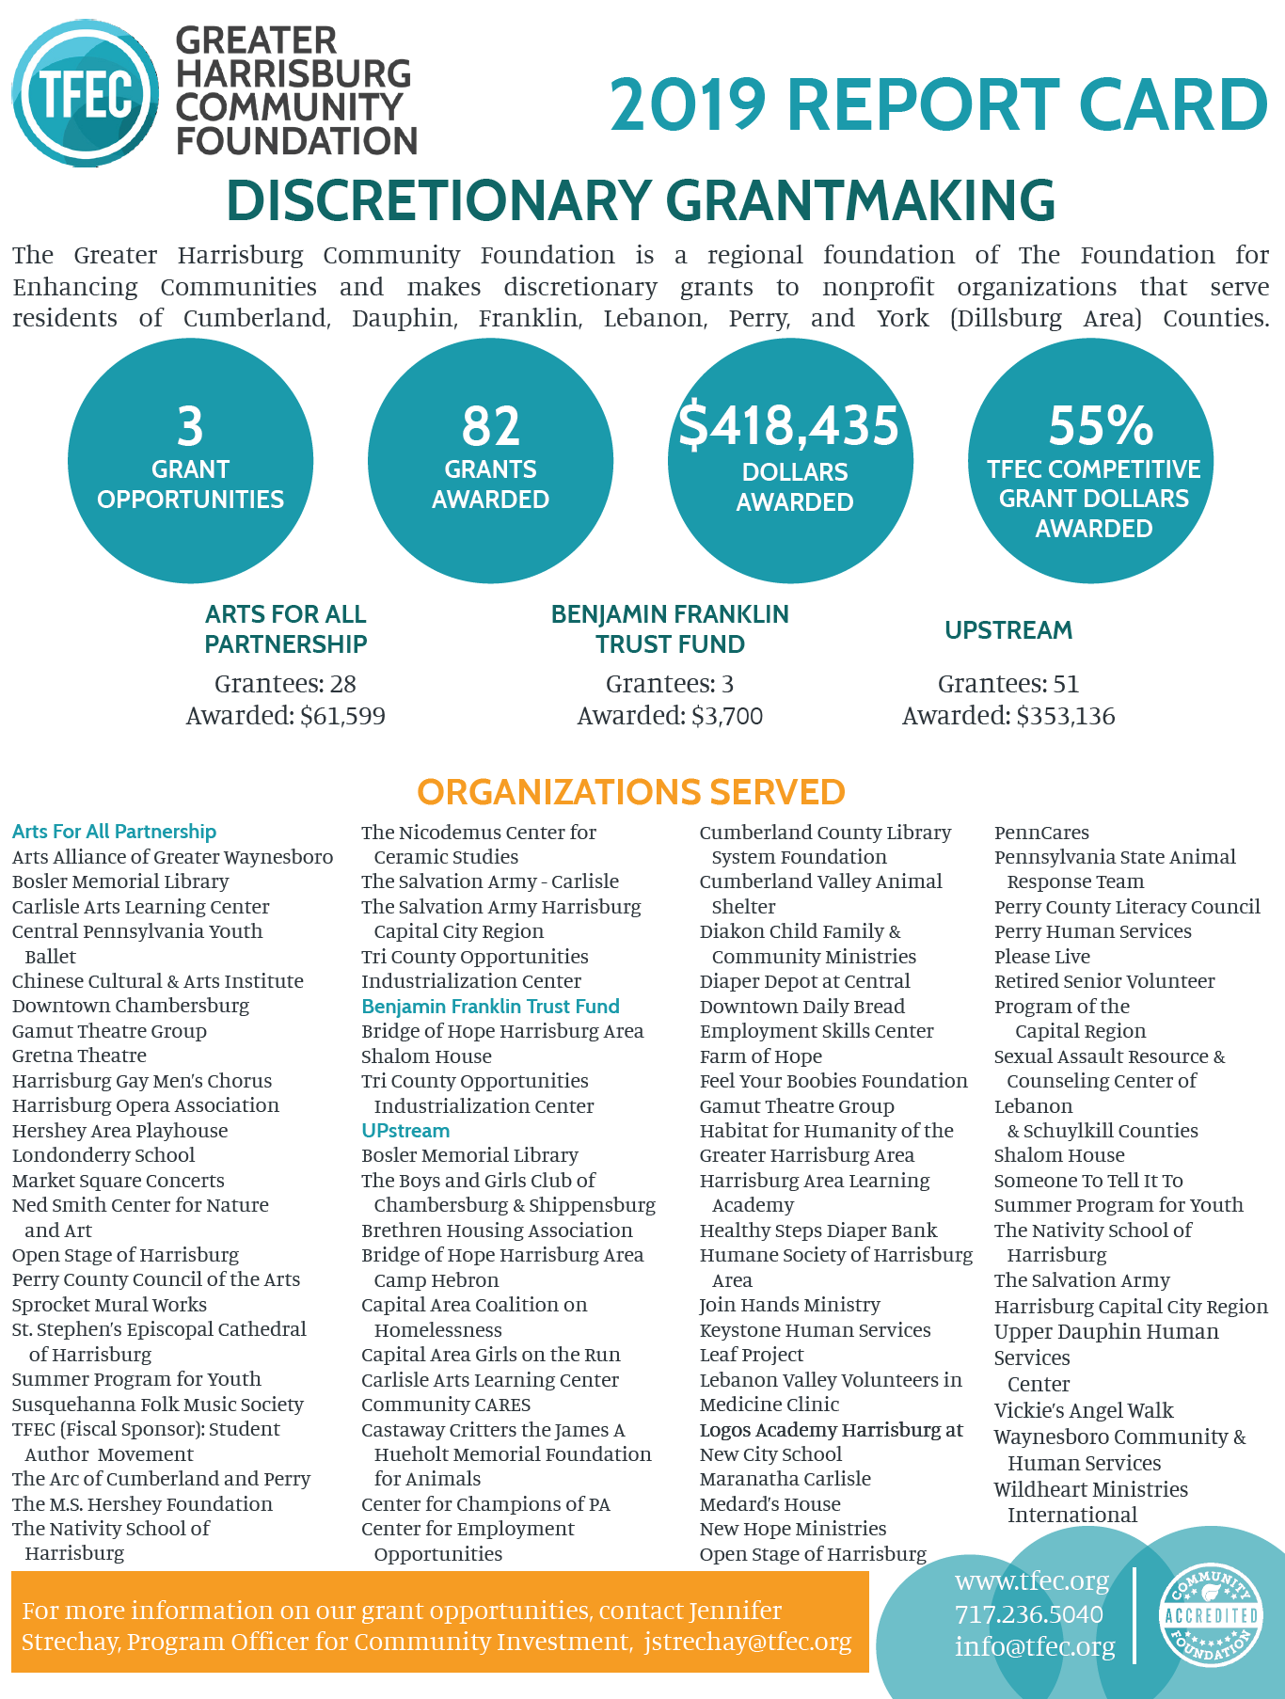
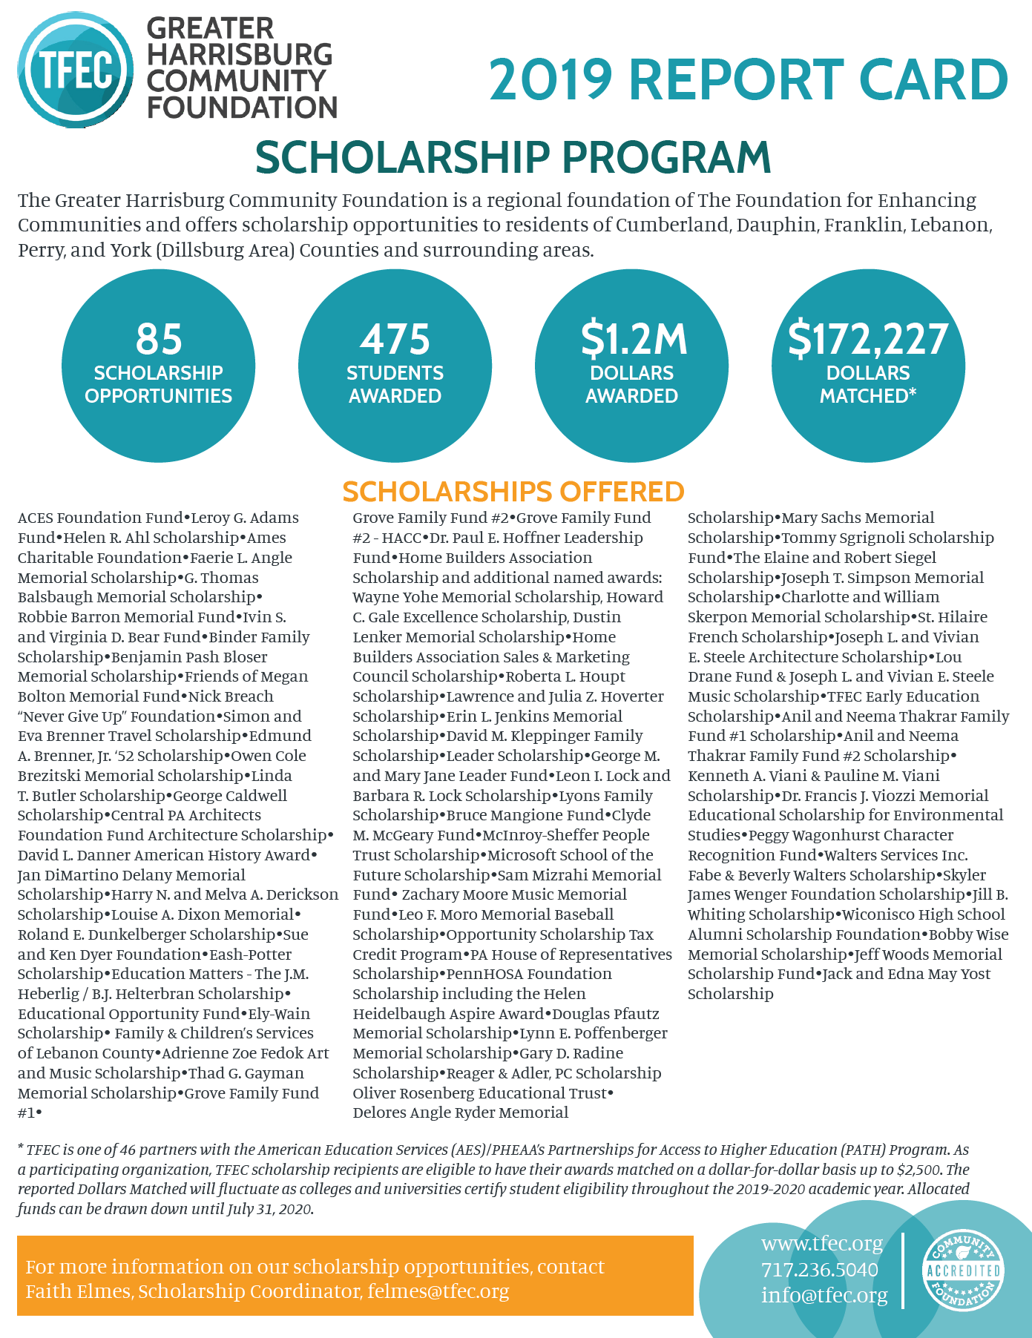
2019 GHCF REPORT CARD

Slide 17
GHCF ANNOUNCED GRANT OPPORTUNITIES
Arts for All Partnership
Ongoing; carried out by its own GHCF committee
This unique collaborative funding initiative aims to improve the efficiency of arts grant funding and increase the overall impact of grant funding for arts programming in our communities.
Greater Harrisburg Community Foundation Benjamin Franklin Trust Fund
Reintroduced in 2018; carried out by the GHCF grantmaking committee
The GHCF Benjamin Franklin Trust Fund grant opportunity seeks to support programs and services that work to increase knowledge and/or quality of life or that inspire positive outcomes for individuals and families living in the service area of Cumberland, Dauphin, Franklin, Juniata, Mifflin, Lebanon, and Perry Counties, and/or the Dillsburg area of York County.
Greater Harrisburg Community Foundation UPstream
Introduced in 2018; carried out by the GHCF grantmaking committee
The GHCF UPstream grant opportunity seeks to improve our area communities by supporting existing or new “upstream” systems, interventions, programs, or projects that attempt to create positive social change by addressing a problem at its source rather than managing its “downstream” symptoms.

Slide 18
GHCF ANNOUNCED GRANT OPPORTUNITIES
Greater Harrisburg Community Foundation Early Childhood Strategic Initiative: Phase Two
Work taking place in 2018-2021
Phase Two of the Early Childhood Strategic Initiative is a four year grant that will serve to connect families to early childhood services and resources by ensuring that quality early childhood services and resources exist and are accessible to children and their families, educators, and the greater community.
Greater Harrisburg Community Foundation Early Childhood Strategic Initiative: Phase 3
Introduced in 2018
GHCF will make an additional investment of $34,000 every year during 2018, 2019, 2020, 2021, and 2022 to support programs and projects that support early childhood education within each of its regional foundations.

Slide 19
GHCF NON-ANNOUNCED GRANT OPPORTUNITIES
Greater Harrisburg Community Foundation: Emergency Needs Grant
Ongoing; Carried out by TFEC staff on behalf of GHCF; awards are reported to GHCF
This interior grant (non-public) consists of a reserve of funds that may be applied to emergency community needs as deemed appropriate by TFEC.
Greater Harrisburg Community Foundation: Patricia L. Murray Fund
Ongoing; Carried out by TFEC Staff on behalf of GHCF
This opportunity seeks grant proposals that “address concerns of women with educational and outreach programs that relate to and enhance the lives of socially and economically deprived individuals”.
These organizations will be invited yearly to apply for grant funding through the Patricia L. Murray Fund.
The American Association of University Women, Harrisburg Branch
The League of Women Voters of the Harrisburg Area
The Susquehanna Arts Museum
The YWCA of Greater Harrisburg

Slide 20
GHCF EARLY CHILDHOOD STRATEGIC INITIATIVE
MISSION
The mission of The Early Childhood Strategic Initiative is to explore and invest in programs that focus on Kindergarten readiness for children ages 3 to 5-years-old who are not in pre-school settings and may, for multiple reasons, have barriers to accessing those services.

Slide 21
GHCF EARLY CHILDHOOD STRATEGIC INITIATIVE
GRANTMAKING
Phase One of the Early Childhood Strategic Initiative consisted of grantmaking to fund pilot research to determine programmatic priorities.
Phase Two of the Early Childhood Strategic Initiative is a four year grant that serves to connect families to early childhood services and resources by ensuring that quality early childhood services and resources exist and are accessible to children and their families, educators, and the greater community.
Within Phase Three, GHCF will make an additional investment of $34,000 every year during 2018, 2019, 2020, 2021, and 2022 to support programs and projects that support early childhood education within each of its regional foundations.
IMPACT
Implementation of Phases One, Two, and Three Early Childhood Strategic Initiative will result in a $500,000 total investment in early childhood education from 2017-2022.

Slide 22
What to expect from the grant team

Slide 23
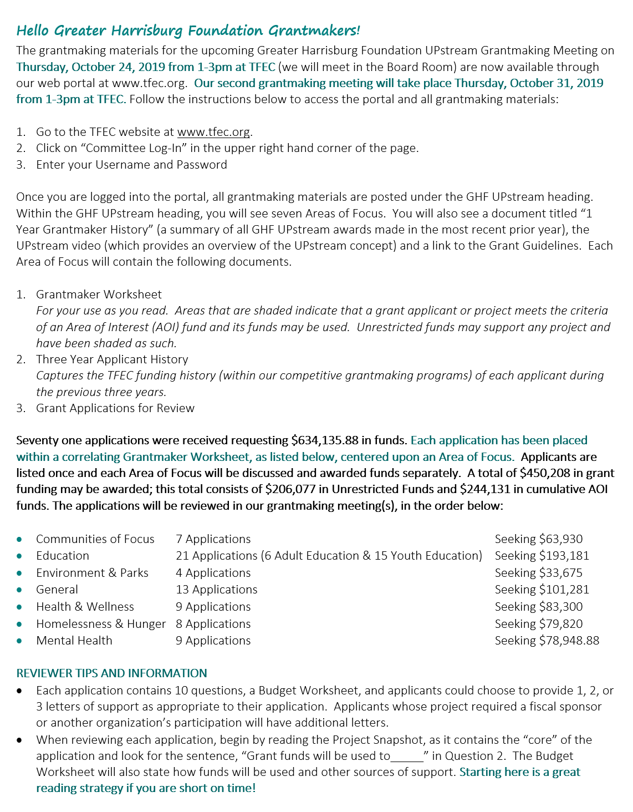
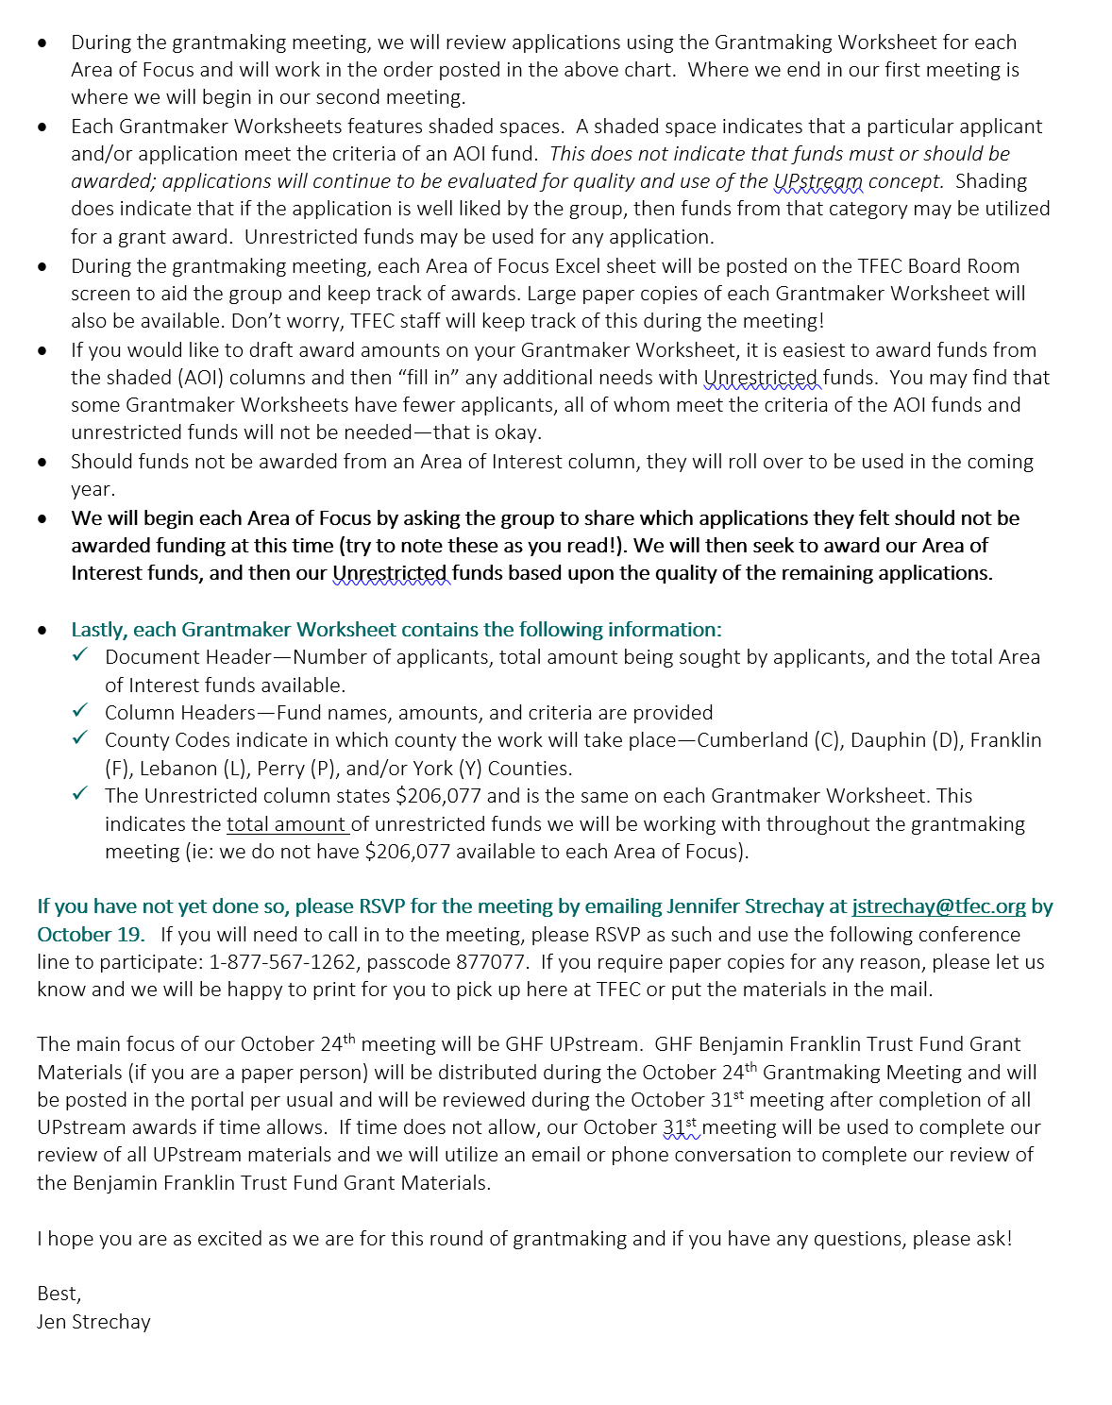
GRANTMAKER MEMO

Slide 24
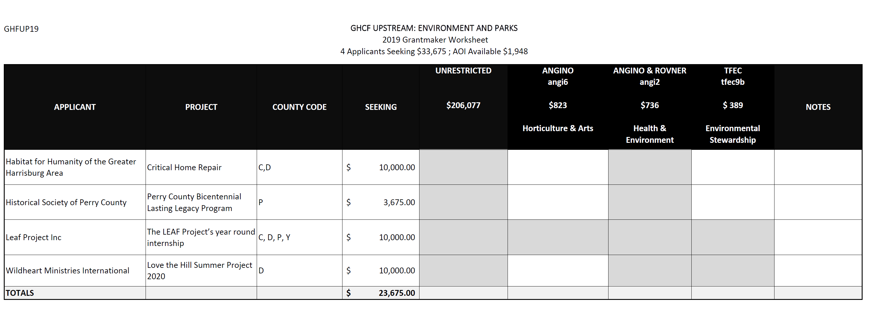
GRANTMAKER WORKSHEET

Slide 25
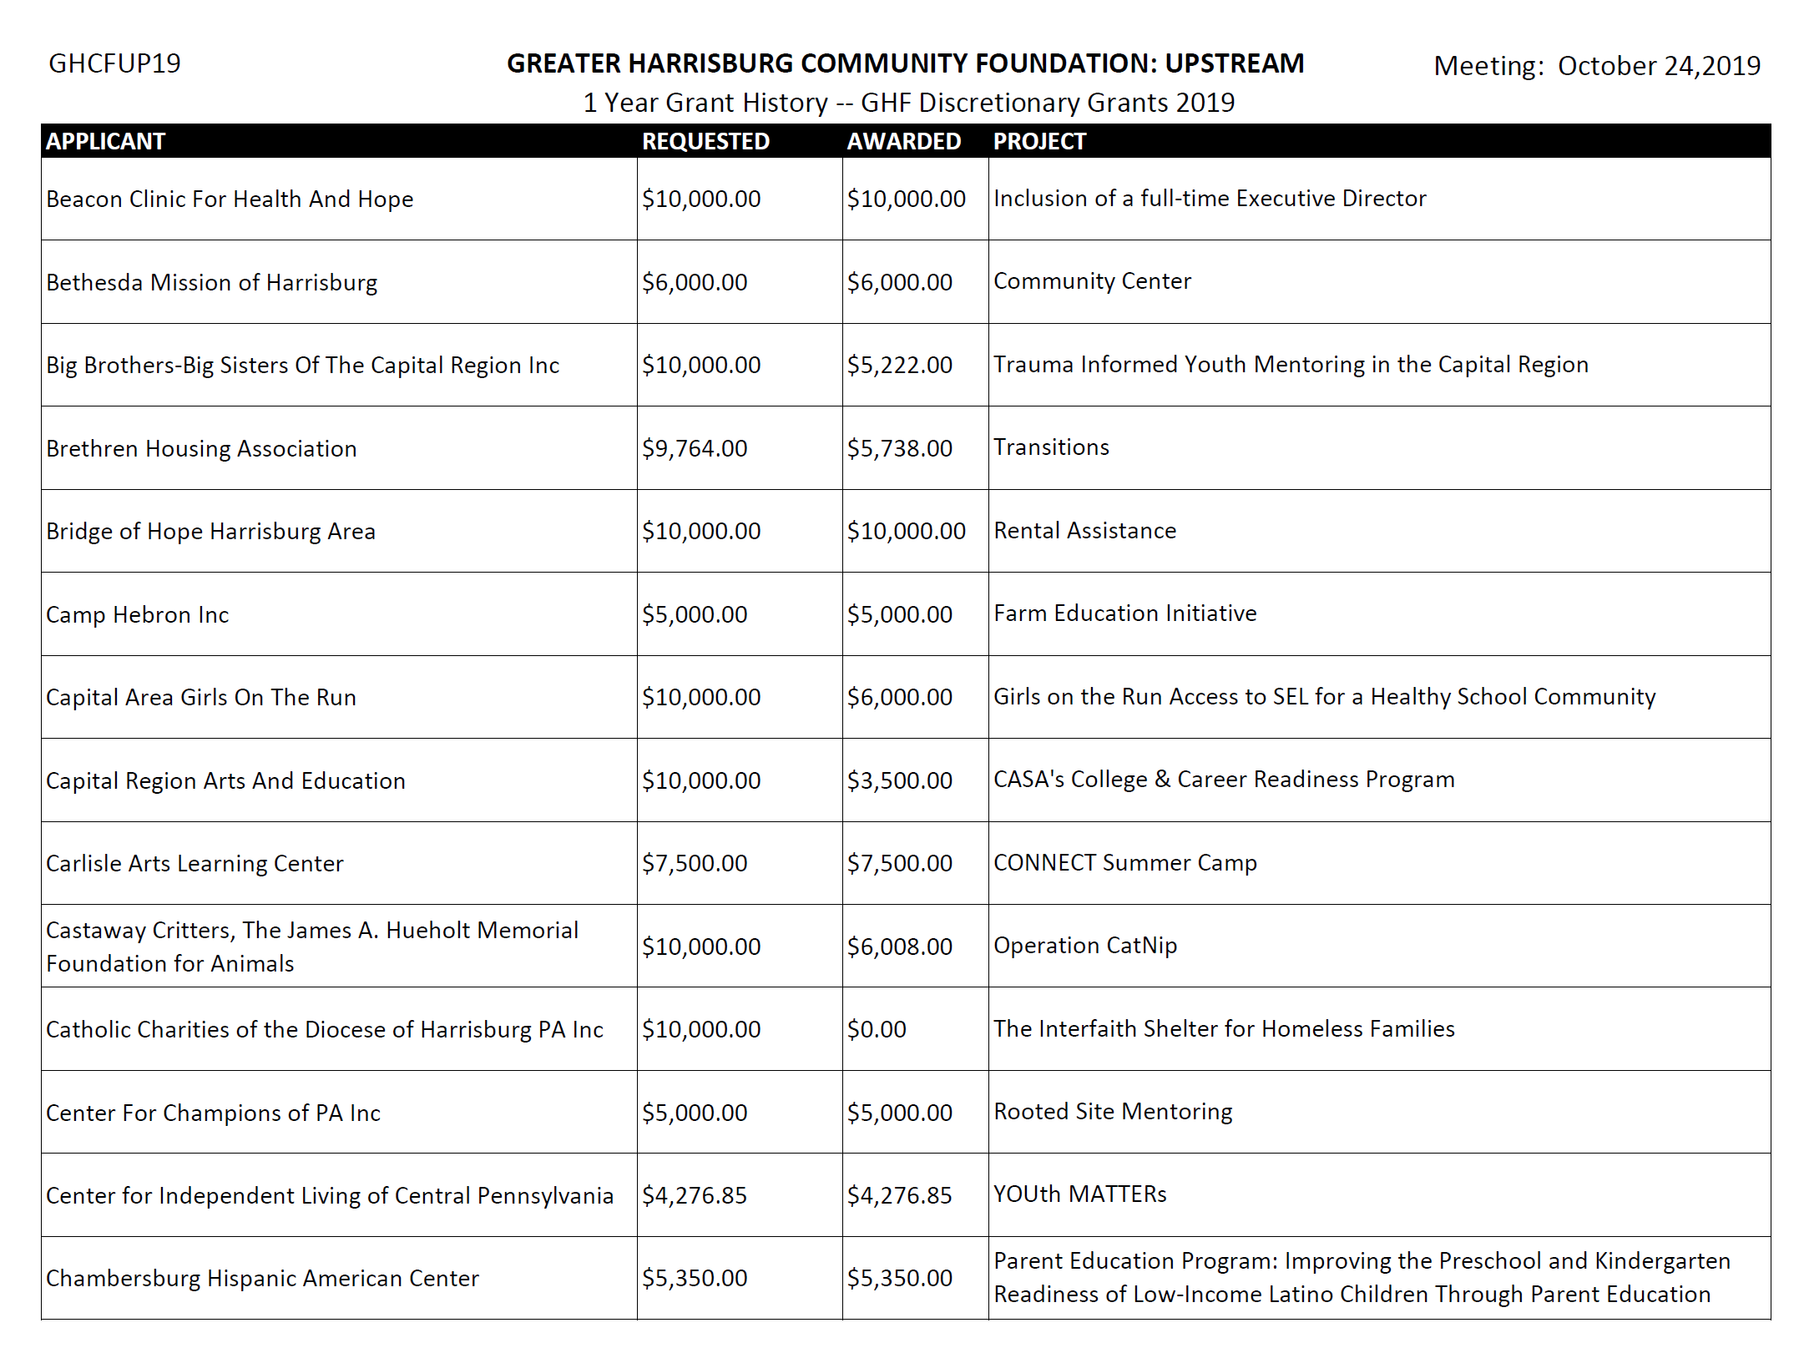
1 YEAR GRANT HISTORY

Slide 26
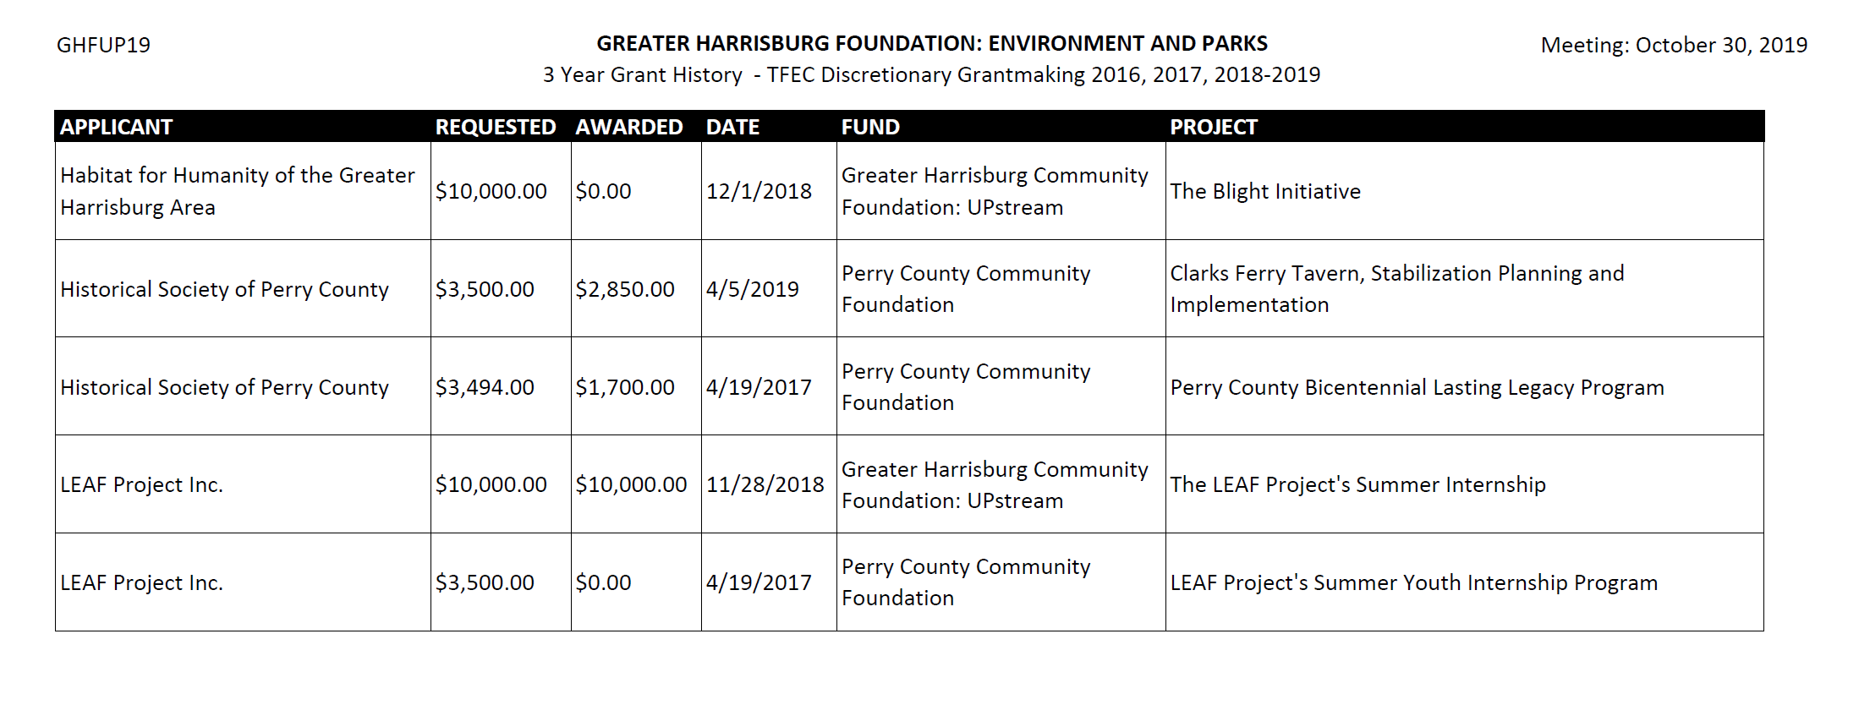
3 YEAR GRANT HISTORY

Slide 27
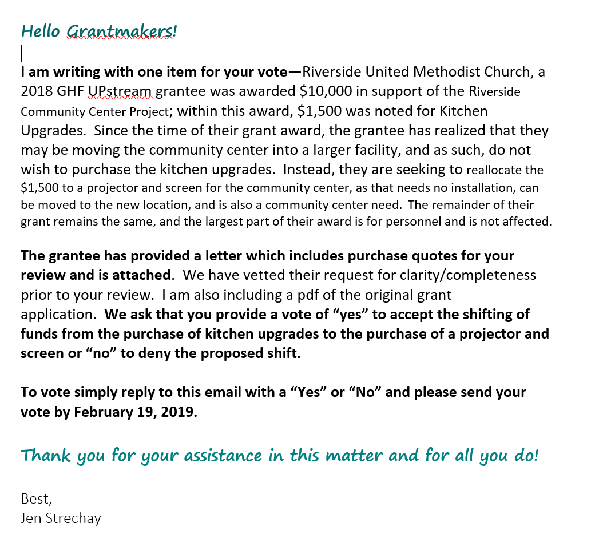
GRANTMAKER VOTE

Slide 28
BECAUSE ALONE WE HAVE IDEAS, AND TOGETHER WE TAKE ACTION.

Slide 29
STAY IN TOUCH!
717.236.5040
Jennifer Strechay
jstrechay@tfec.org
www.tfec.org
/tfec.hbg
Andrea R. Iguina-Pérez
aiguina@tfec.org
@tfechbg

